Slide 1
Falsified/Fake News Detection using Machine Learning Techniques

Slide 2
OVERVIEW
01
04
Datasets
Problem Statement and Introduction
02
05
Implementation
Architecture Overview
03
Related Works
06
Results & Conclusion

Slide 3
PROBLEM STATEMENT
The proliferation of fake news has become a critical challenge in today's digital age.
With the ease of content creation and rapid information dissemination through social media platforms, distinguishing between genuine and fabricated news has become increasingly difficult.
The problem of fake news poses severe consequences, including the erosion of public trust, manipulation of public opinion, and potential harm to individuals and societies.

Slide 4
SOLUTION
Fake news detection using machine learning techniques offers a promising solution to the pervasive problem of misinformation. By harnessing the power of ML algorithms, it becomes possible to analyze vast amounts of textual data and identify patterns indicative of fake news.
We collected a dataset of news articles from different sources and manually labeled them as either fake or real.
We preprocessed the data by cleaning and tokenizing the text, and then used a machine learning algorithms to model the sequence of words in the news articles.
The model was trained on a subset of the data and then evaluated on a held-out test set.
We experimented with different hyperparameters and regularization techniques to optimize the performance of the model.

Slide 5
INTRODUCTION
The Internet is widely recognized as a significant technological breakthrough, with millions of users worldwide.
The individuals and content posted on these sites are not vetted in any way.
Some individuals attempt to disseminate false information through various mediums.
Propaganda may take the form of false news stories that target specific people, groups, or even political parties.
There must be machine learning classifiers capable of automatically identifying such disinformation campaigns.
This project implements the same by using of machine learning classifiers for identifying disinformation.

Slide 6
INTRODUCTION
In artificial intelligence, machine learning is what enables the creation of self-improving systems.
To begin, a data collection known as the train data set must be used to instruct the algorithms.
As a result of their training, these algorithms may be put to a variety of uses. Different industries are using ML for a wide range of purposes.
Predictive or covert detection tasks are common applications of machine learning systems

Slide 7
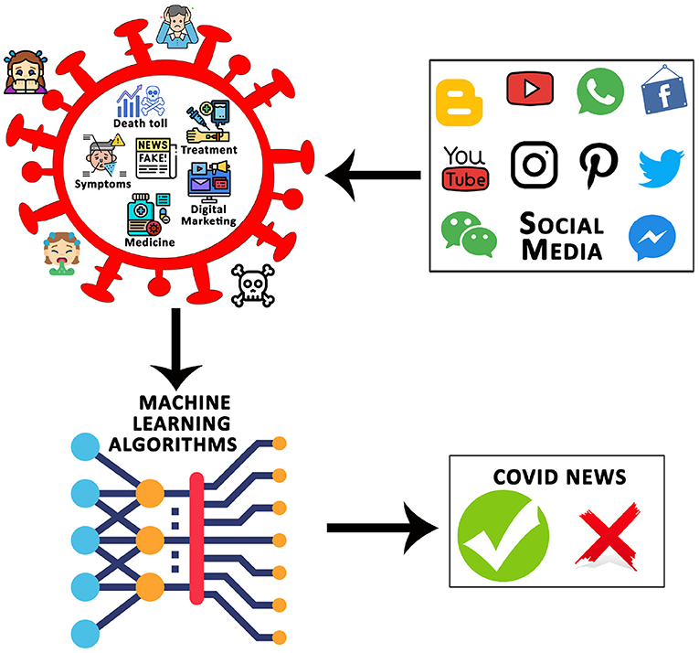
ARCHITECTURE OVERVIEW
01
02
Data Collection
Data Preprocessing
03
04
Modeling
Data Visualization
5
Evaluation

Slide 8
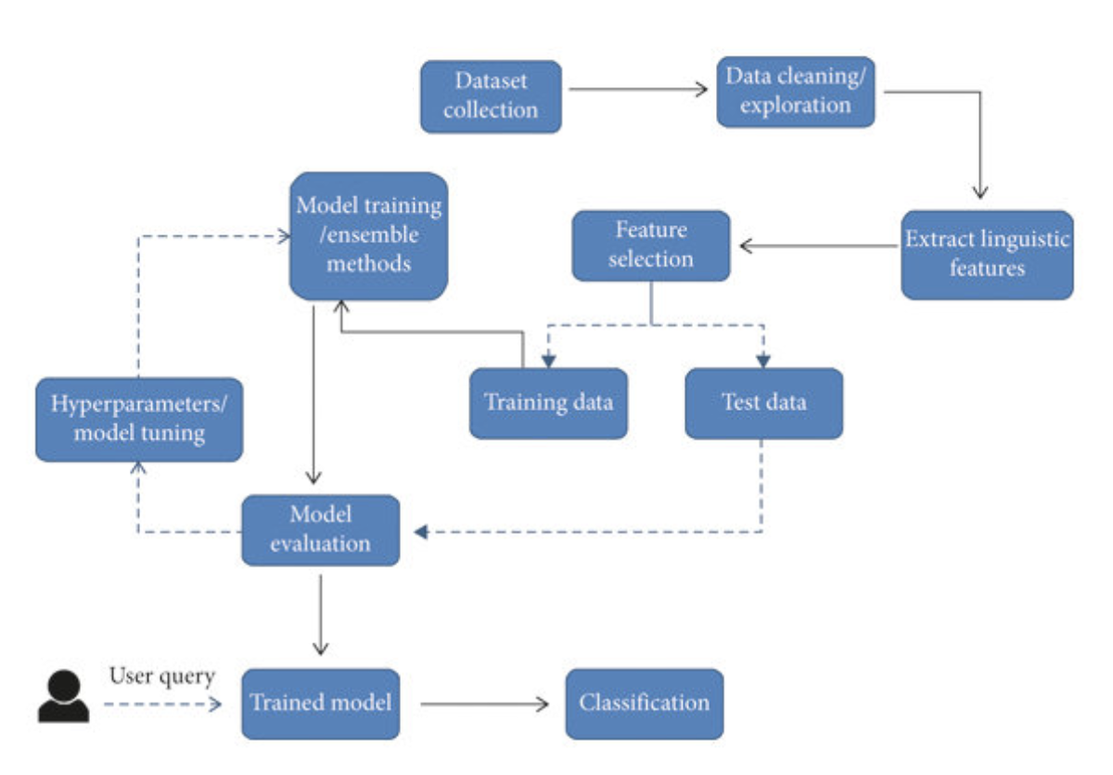
ARCHITECTURE OVERVIEW

Slide 9
Related Works
Detecting Fake News on Social Media Using Geometric Deep Learning" by Wang et al. (2021) - In this study, the authors used a graph-based approach to detect fake news on social media. They used a Graph Convolutional Network (GCN) to extract features from the graph and a Support Vector Machine (SVM) classifier to classify the news as fake or real.
"Fake News Detection on Social Media using Machine Learning: A Systematic Review" by Elsayed et al. (2020) - This paper provides a comprehensive review of the state-of-the-art techniques for fake news detection on social media
"Fake News Detection using LSTM Neural Networks" by Chakraborty et al. (2019) - In this study, the authors used an LSTM neural network to detect fake news. They used a dataset of news articles collected from various sources and preprocessed the data to remove stop words, punctuation, and other noise. proposed method achieved an accuracy of 93% in detecting fake news.
.

Slide 10
Related Works
"Fake News Detection using Multi-Source Information and Multi-Modal Learning" by Liu et al. (2021) - In this study, the authors proposed a multi-modal learning approach for fake news detection, which used information from multiple sources, including the text, images, and user comments. The proposed method achieved an accuracy of 91.3% in detecting fake news.
"Fake News Detection using Transfer Learning and Adversarial Training" by Wang et al. (2020) - In this study, the authors proposed a fake news detection method that used transfer learning and adversarial training. The model was trained on a large dataset of news articles and was able to achieve an accuracy of 94.6% in detecting fake news.

Slide 11

Datasets
A fake news dataset is a collection of text data that has been labeled as either fake or real news.
These datasets are used to train machine learning models to detect fake news and classify news articles as either fake or real.
These datasets are typically created by collecting news articles from various sources and manually annotating them as fake or real.
The dataset is split into training and testing sets and was created for a Kaggle competition

Slide 12
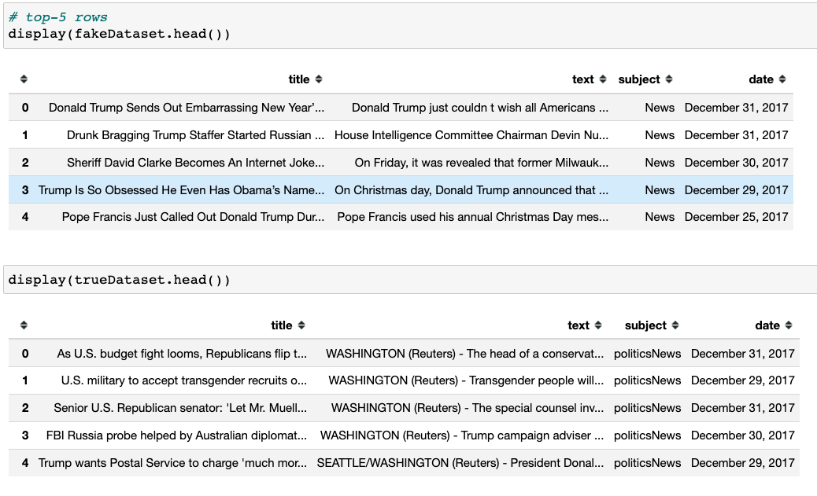
Datasets

Slide 13
Datasets
These datasets are essential for developing and evaluating fake news detection models.
They provide a diverse set of news articles with varying degrees of credibility, allowing researchers to create models that are robust and generalize well to different types of data.
There are two datasets one for fake news and one for true news. In true news, there is 21417 news, and in fake news, there is 23481 news.
Both datasets have a label column in which 1 is for fake news and 0 for true news.
We combined both datasets using pandas' built-in function.

Slide 14
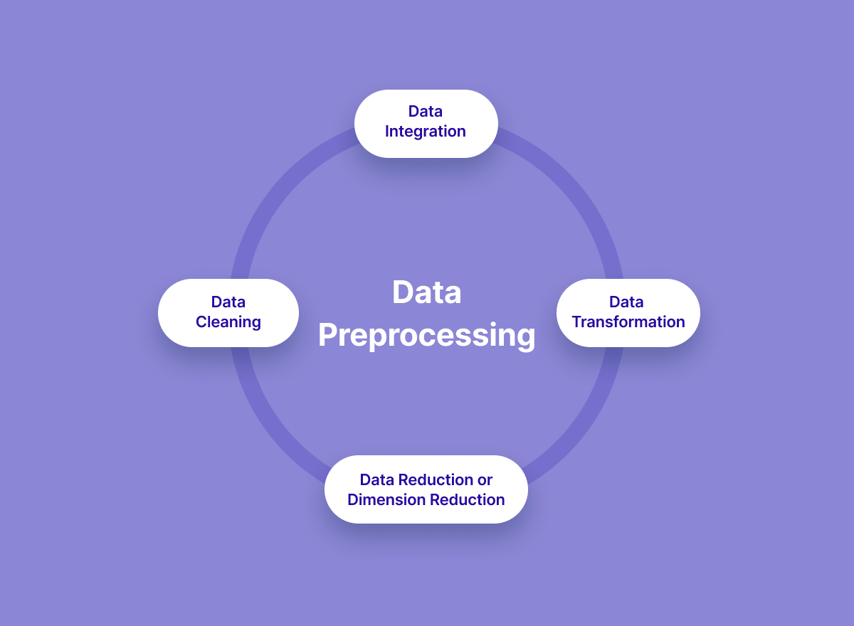
Data Quality
Data Cleaning
Feature Selection
Data Normalization

Slide 15

Dataset Visualization
One common type of visualization used in natural language processing is the word cloud.
A word cloud is a graphical representation of the most frequently occurring words in a piece of text.
Word clouds are useful in visualizing the most important or prominent words in a corpus of text.
This can be helpful in identifying patterns or topics that emerge from the data, as well as in identifying common words or phrases that may be useful in feature extraction or other natural language processing tasks.
For example, in fake news detection, a word cloud can help to identify frequently used words in both fake and real news articles, which can be used to inform feature selection and other preprocessing steps.

Slide 16
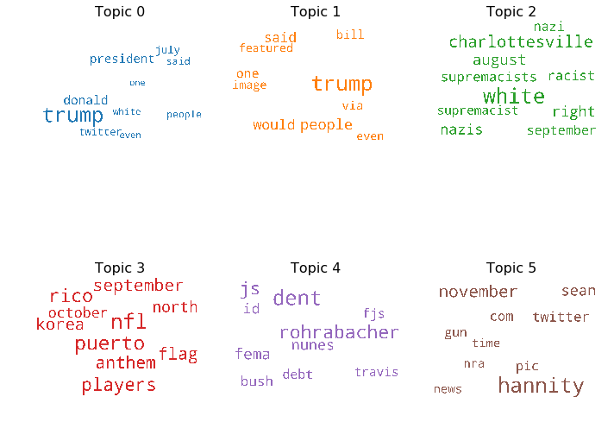
Dataset Visualization

Slide 17
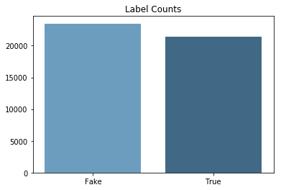
Dataset Visualization
A bar chart showing label counts is a common visualization used in machine learning and data science to understand the distribution of classes in a dataset. In the context of fake news detection, a bar chart can be used to show the frequency of real and fake news labels in the dataset.

Slide 18

Modeling
Machine learning is a subfield of artificial intelligence that involves the development of algorithms that can learn from data and make predictions or decisions without being explicitly programmed.
One area where machine learning is particularly useful is in the detection of fake news. Fake news is a type of news that is deliberately spread to misinform or deceive people.
It can be difficult to detect because it often uses techniques such as sensational headlines, emotional language, and misleading images to grab people's attention and spread quickly on social media.
Fake news can have serious consequences, such as influencing elections, inciting violence, and damaging people's reputations. This has led to a growing need for automated tools to detect fake news.

Slide 19
Evaluation
Accuracy
Accuracy = (TP + TN) / (TP + TN + FP + FN)
Precision
Precision = TP / (TP + FP)
Recall
Recall = TP / (TP + FN)
F1
F1 Score = 2 * (Precision * Recall) / (Precision + Recall)

Slide 20
Results and Discussion
The results of using different machine learning algorithms for fake news detection are as follows. Logistic Regression achieved an accuracy of 67% on the test set. The precision, recall, and F1-score for both classes (fake and real) were similar, indicating a balanced performance.
Comparing the results, Adaboost stands out as the best-performing algorithm with the highest accuracy and strong precision, recall, and F1-score for both classesIt is worth noting that the choice of a machine learning algorithm can significantly impact the performance of the fake news detection system.
Adaboost and Random Forest show promise in achieving high accuracy, while Logistic Regression and KNN may require further optimization or feature engineering to improve their performance.

Slide 21
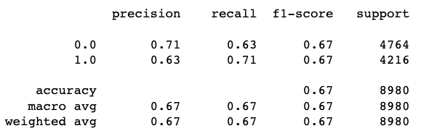
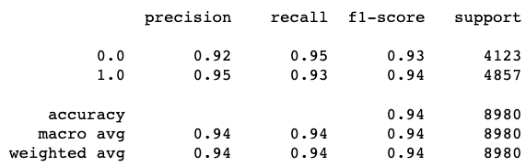
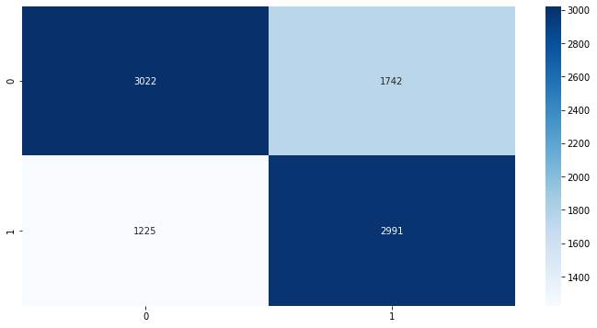
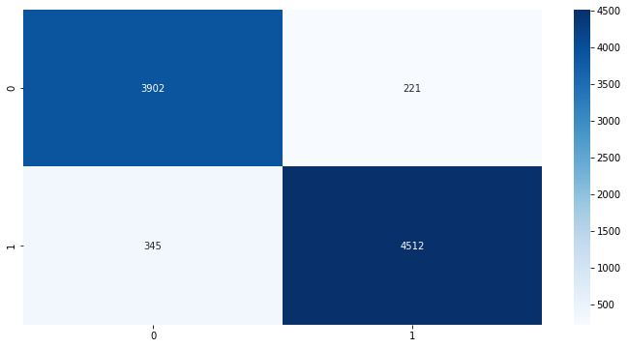
Results and Discussion

Slide 22
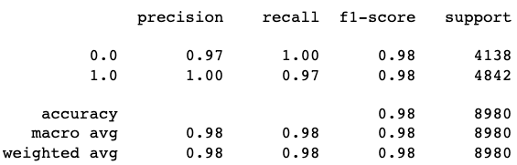
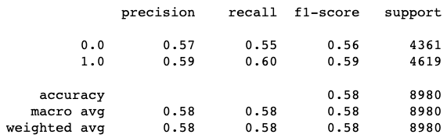
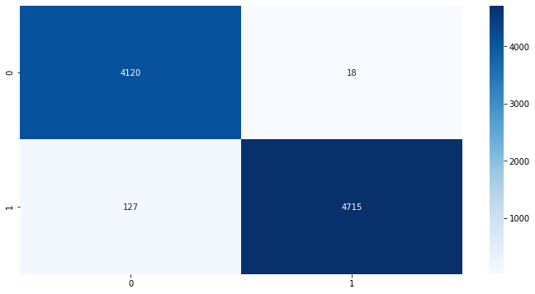
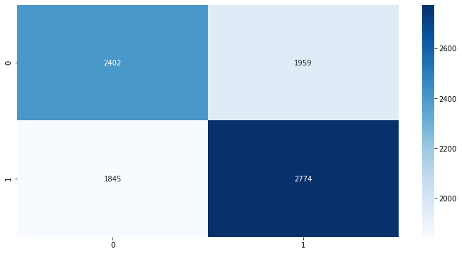
Results and Discussion

Slide 23
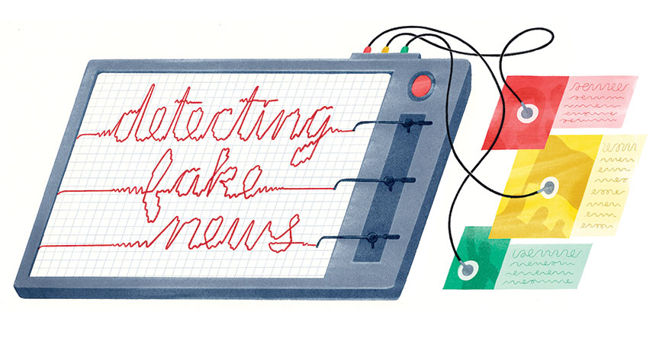
Conclusion
The choice of the machine learning algorithm is crucial in developing an effective fake news detection system.
AdaBoosting and Random Forest exhibited strong performance in accurately distinguishing between fake and real news articles.
Logistic Regression and KNN may require further optimization or feature engineering to enhance their performance.
It is important to consider not only accuracy but also other evaluation metrics such as precision, recall, F1-score, and ROC AUC when assessing the performance of fake news detection models.
Additionally, factors like model interpretability, robustness, and scalability should be taken into account to build a comprehensive and effective solution for detecting and combating fake news.

Slide 24
Contribution
The project contribution is split between three members :
Aditya , Nikith , Sai Snusha Nakka.
Aditya – Data Collection , Training
Snusha – Data Preprocessing and Data Visualization, Semantic Analysis
Nikith – Modeling, Evaluation

Slide 25
References
Gupta, A., Kumar, S., & Yadav, O. (2018). Fake news detection on social media: A machine learning perspective. In Proceedings of the 27th International Conference on World Wide Web (pp. 1453-1462).
Song, W., Wei, F., & Li, J. (2020). Deep learning based fake news detection: A survey. arXiv preprint arXiv:2008.05781.
Mohtarami, A., Alborzi, H., & Abedin, B. (2019, November). Fake news detection on social media: A machine learning perspective. In 2019 IEEE 3rd International Conference on Data Science and Systems (DSS) (pp. 174-179). IEEE.
Gibney, P. (2018). A machine learning approach for detecting fake news on social media. arXiv preprint arXiv:1812.11191.
​​Potthast, M., Kiesel, J., Reinartz, K., Bevendorff, J., Stein, B., & Hagen, M. (2018). A stylometric inquiry into hyperpartisan and fake news. arXiv preprint arXiv:1811.00888.
Thorne, J., Vlachos, A., Christodoulopoulos, C., & Mittal, A. (2018). FEVER: a large-scale dataset for Fact Extraction and VERification. arXiv preprint arXiv:1803.05355.
Yang, Z., Dai, Z., Yang, Y., Carbonell, J. G., Salakhutdinov, R. R., & Le, Q. V. (2019). XLNet: Generalized Autoregressive Pretraining for Language Understanding. Advances in neural information processing systems, 32, 5754-5764.

Slide 26
THANK YOU

